Slide 1



Summary Week 1 + 2
Ba Nguyen Quoc Anh

Slide 2
Week 1
Week 2
Install and get familiar with:
Get familiar with Angular 16
Angular structures: component, module, service, pipe, directive
Operations: binding data, user event, error handling
TypeScript concepts: interface
ng CLI / Angular 13
node / npm / nvm
git CLI / git

Slide 3


Angular Structures
Building-blocks for constructing a web application.
Component, Module, Service
Pipe, Directive

Slide 4
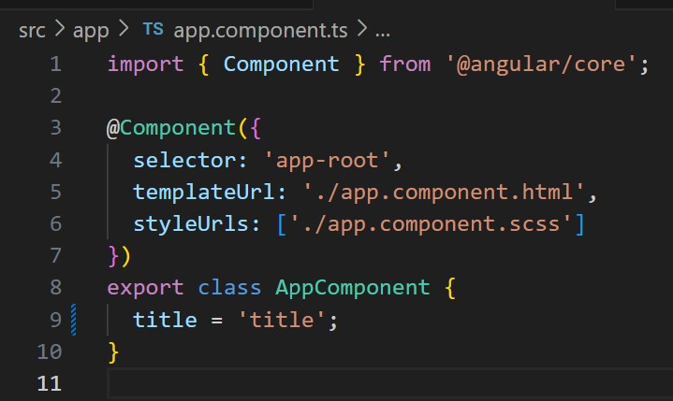


Structures
Components

Slide 5
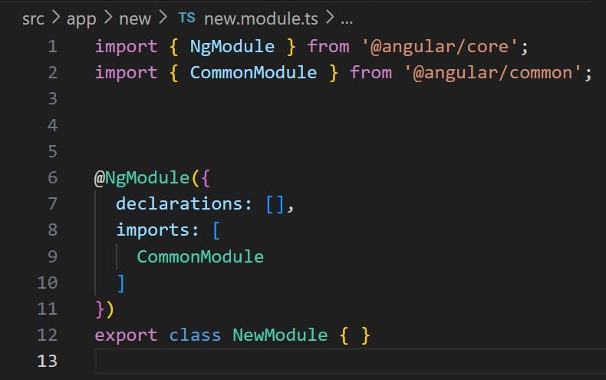
Structures
Module

Slide 6
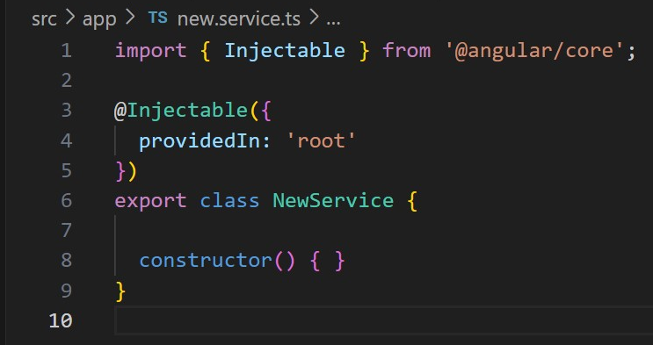
Structures
Service

Slide 7
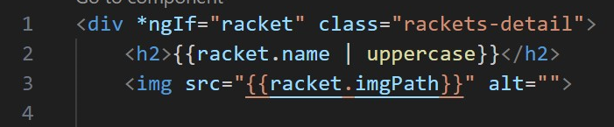
Structures
Pipe

Slide 8
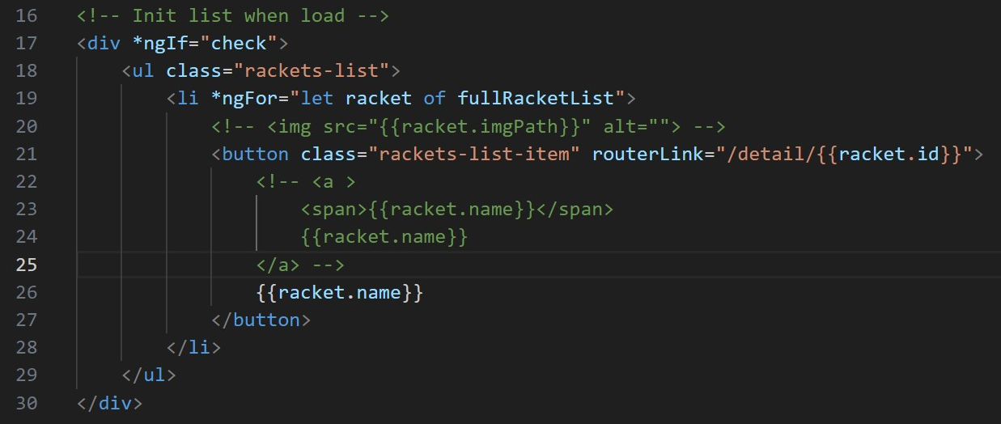
Structures
Directive

Slide 9
Angular Operations
Provides communication between User (client) - Application - Server
Binding data
User Events
Error handling

Slide 10
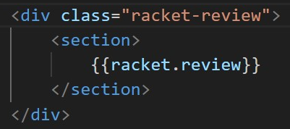

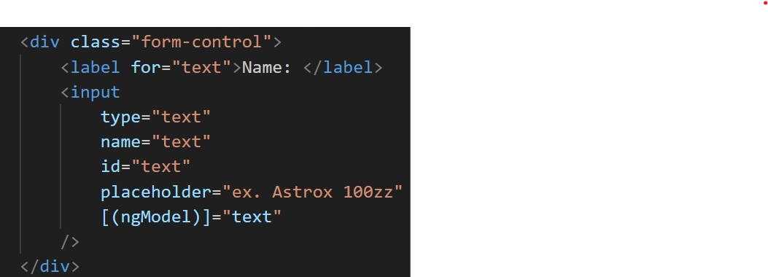

Operations
Binding data

Slide 11
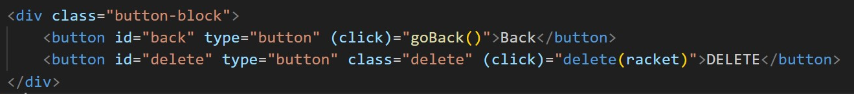
Operations
User Events

Slide 12
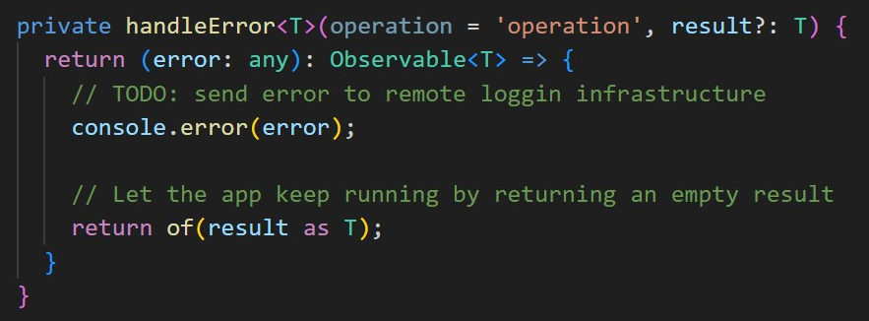
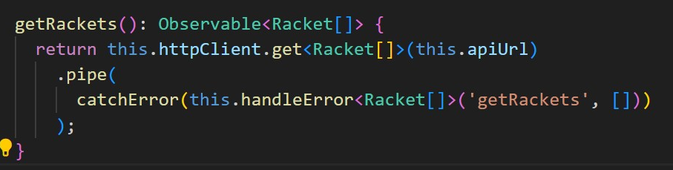
Operations
Error Handling

Slide 13
TypeScript
A more complete version of JavaScript.
Interface

Slide 14
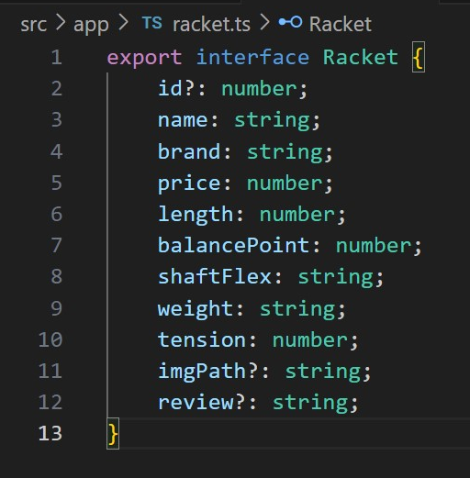
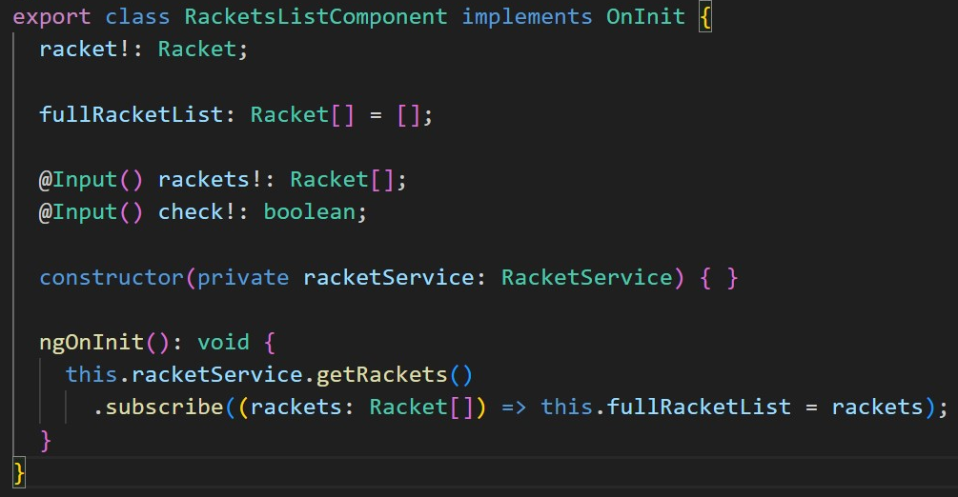

Interface

Slide 15
Demo Time

